Slide 1

From EAI to Serverless
Evolution of Integration patterns and architectures
Digital Exchange 2019, Gummersbach 2019/05/25

Slide 2

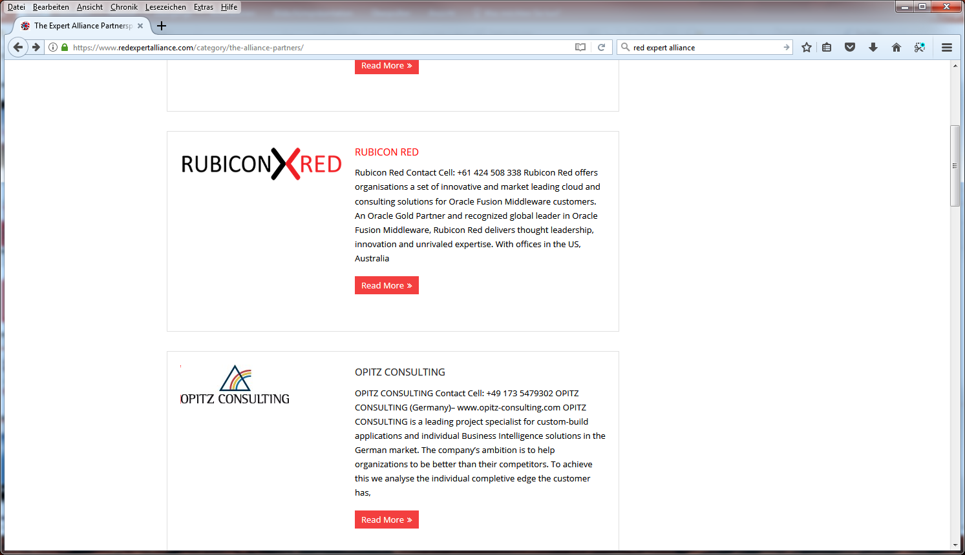






Red Expert Alliance - Who we are

Slide 3



Who are we?
Lucas Jellema (AMIS, NL)
Arturo Viveros (Sysco, NO)
Sven Bernhardt (OPITZ, DE)

Slide 4
Agenda
What is integration?
Integration challenges
“Traditional” integration approach
Recents insights and developments
Integration Patterns
Out of the Box
Conclusion
Notes:
1) Introduction: What is integration? (Panel)
2) Common challenges (anecdotes, horror stories) (Panel)
3) Traditional approaches (Single person)
4) Typical challenges of the traditional approaches (Panel)
5) Recent insights/developments (Panel)
6) 3 Main integration styles (Single person per integration style)
6.1) Vertical
6.2) Horizontal
6.3) Event-Based
7) Asynchronous is almost always better (single person)
8) Think out of the box (Single person)
9) Conclusion: what is the same today with integration, what has not changed and also what changed? (Panel)

Slide 5
What is integration?

Slide 6
What is integration?
Simple definition: enabling systems to talk to each other
X
X
System A
System B
Notes:
Arturo’s notes:
-For a long time we have thought of system integration as the process of aggregating several subsytems to look and behave as one big system, usually known to the business as “the system”. Under this paradigm, centralizing elements such as data, business rules, transformation rules, UIs, etc. becomes key and thus the relevance of the term “middleware” when it comes to traditional EAI. Nowadays though, with evolved technology, improved delivery channels and increased awareness, we’re not so concerned about centralizing anymore, and even in some cases we want to start decentralizing in order to reap the benefits and flexibility of modern distributed systems, but also to reduce overhead and give breathing room to middleware platforms which are at risk of becoming unmanageable.
-So what I mean to say is that system integration has become increasingly complex as the general IT landscape and the requirements grow in complexity as well; however, recent insights and developments have enabled us to reverse this trend by going back to simpler patterns and paradigms which are better suited to cope efficiently with the growing complexity of the world around us from an integration perspective.
-That being said and regardless of the methods we choose, there are a number of goals, principles, facts, etc. which we’ve known to be true for a long time and still are after all of our experiences, for example: spaghetti integration is a no-no, well-designed common data models and standards can be very useful, discoverability and neat service contracts add huge value to our efforts, heavy vendor lock-in is a big liability, etc.

Slide 7
What is integration?
Ensure that data is where it is needed when it is needed in the form in which it is needed
System A
System B
Notes:
Arturo’s notes:
-For a long time we have thought of system integration as the process of aggregating several subsytems to look and behave as one big system, usually known to the business as “the system”. Under this paradigm, centralizing elements such as data, business rules, transformation rules, UIs, etc. becomes key and thus the relevance of the term “middleware” when it comes to traditional EAI. Nowadays though, with evolved technology, improved delivery channels and increased awareness, we’re not so concerned about centralizing anymore, and even in some cases we want to start decentralizing in order to reap the benefits and flexibility of modern distributed systems, but also to reduce overhead and give breathing room to middleware platforms which are at risk of becoming unmanageable.
-So what I mean to say is that system integration has become increasingly complex as the general IT landscape and the requirements grow in complexity as well; however, recent insights and developments have enabled us to reverse this trend by going back to simpler patterns and paradigms which are better suited to cope efficiently with the growing complexity of the world around us from an integration perspective.
-That being said and regardless of the methods we choose, there are a number of goals, principles, facts, etc. which we’ve known to be true for a long time and still are after all of our experiences, for example: spaghetti integration is a no-no, well-designed common data models and standards can be very useful, discoverability and neat service contracts add huge value to our efforts, heavy vendor lock-in is a big liability, etc.

Slide 8
Integration challenges

Slide 9

Integration Challenges
Monolithic / aging systems
Disparate data models
Architectural complexity
Heterogeneous ecosystem
Technical debt
Bloated projects / overhead
Visibility / error handling
Production deployment
Notes:
Arturo’s notes:
-I think we know the challenges quite well and the audience should be familiar with our experiences and horror stories; an interesting point when we’re looking at a traditional approach where an organization’s expensive middleware / ESB is supposed to “magically” solve every integration challenge through tons of features and adapters, is that the rest of systems and components in the ecosystem tend to happily incur and accumulate technical debt as they would claim that these issues are for the integration layer to fix / sort out. This kind of dynamic isn’t healthy nor conducive to innovation, agility, scalability, etc. which are characteristics associated with solving contemporary IT challenges and modern application development.

Slide 10
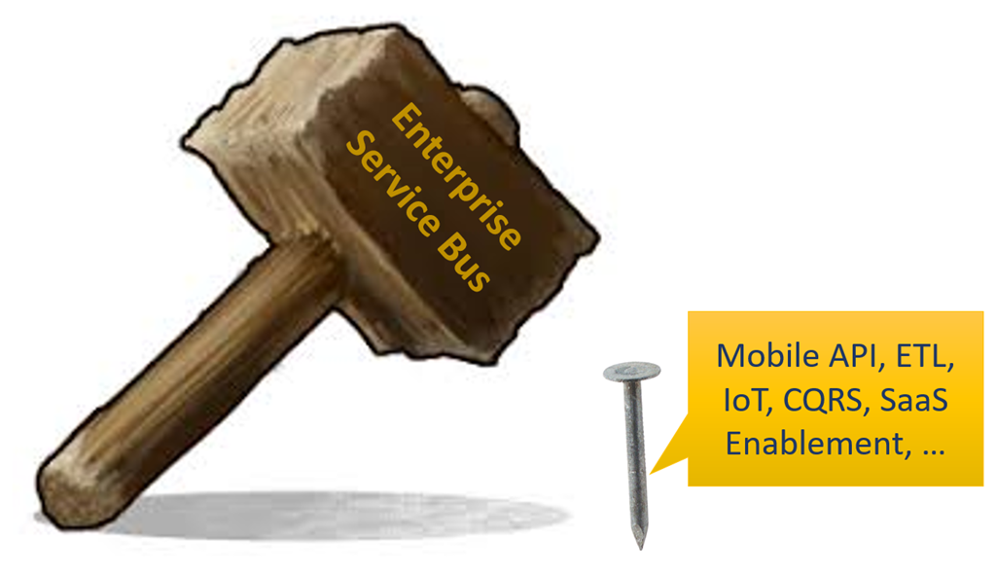
Notes:
Our tool of choice is the ESB - and any integration challenge is a nail that we will hit with that hammer

Slide 11
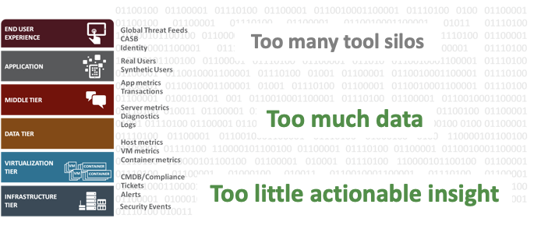
IT organizations are drowning

Slide 12
“Traditional” integration approach
Notes:
Within this section we’ll also talk about challenges, as well as horror stories and anecdotes

Slide 13






ESB as basic architecture element
global
internal
specific
External Interfaces – Proxy Servics
Integration Logic
Internal Interfaces – Business Interfaces

Slide 14
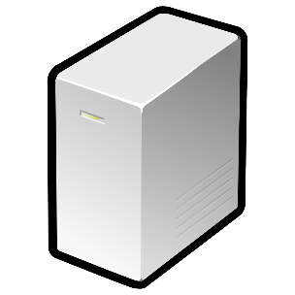




Limited and expensive Scalability
Loadbalancer
ESB 1
ESB 2
ESB 3

Slide 15

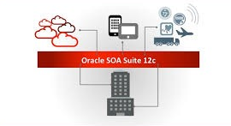







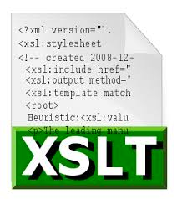

Caught in a technology Trap
Oracle SOA Cloud Service
Fixed Technologies Set
{
„dialect“:“JSON“
}
<XML />

Slide 16
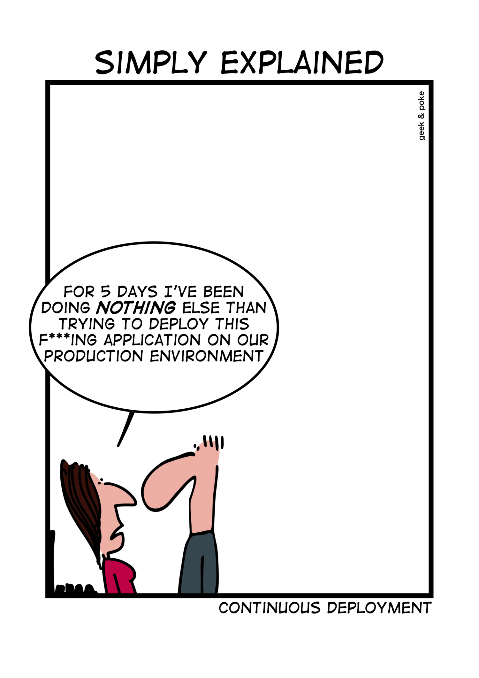
Limited agility
Hard to implement Continuous Integration / Continuous Delivery
Complex infrastructure
Missing automated testing capabilities
Monolithic deployment approach
Expert knowledge needed
Implementation
Deployment
Error analysis
http://geek-and-poke.com/
Notes:
http://geek-and-poke.com/

Slide 17
Recent insights and developments
Notes:
What has changed? What have we learned?
- integration in the past decade was frequently less than wildly successful; complex, expensive, slow, unstable, un-agile
one of the key distinctions in my mind between SOA (WebServices) and API: less focus on reuse, more focus on the consumer of an API
With further increased scale – because of real time and web scale demands introduced by IoT and a further growth of the use of Apps – ,
No/less strict delineation between Enterprise (message based) Integration and ETL/Data Integration
tighter security requirements,
faster change cycle (Agile, DevOps),
24/7 Operations
increased usage of standard applications (primarily SaaS)
and the advent of cloud (necessity to support hybrid scenarios - cross on premises and cloud as well as multi vendor cloud,
that inspired new architecture patterns and insights such as domain driven design, microservices, CQRS, event sourcing, “dumb pipes, smart end points” combined with
advances in technology and industry standards – for example containers, serverless, REST, API technology – JSON (vs XML), REST (vs SOAP), containers, serverless, “embedded HTTP server”, industry standards like Kafka
Potential of machine learning
Scarcity of talent/developers
Is a canonical model/language such a good idea? What about ‘domain/context mapping’ and ‘anti corruption layer’ from domain driven design

Slide 18
New insights, new context
increased scale – because of real -time and web scale demands introduced by IoT and a further growth of the use of Apps
Need for speed - real time insights from fast data streams
No/less strict delineation between Enterprise (message based) Integration and ETL/Data Integration
tighter security requirements,
faster change cycle (Agile, DevOps),
24/7 Operations
Scarcity of talent/developers
Is a canonical model/language such a good idea? What about ‘domain/context mapping’ and ‘anti corruption layer’ from domain driven design
We have learned to ask: How fresh should data be? How crucial is ACID and instant consistency?
increased usage of standard applications (primarily SaaS)
the advent of cloud (necessity to support hybrid scenarios - cross on premises and cloud as well as multi vendor cloud,
new architecture patterns such as domain driven design, microservices, CQRS, event sourcing, “dumb pipes, smart end points”
advances in technology, containers, serverless, REST, API technology – JSON (vs XML), REST (vs SOAP), containers, serverless, “embedded HTTP server”, industry standards like Kafka
TCO of Middleware Platforms
Strategic roadmap of middleware vendors

Slide 19
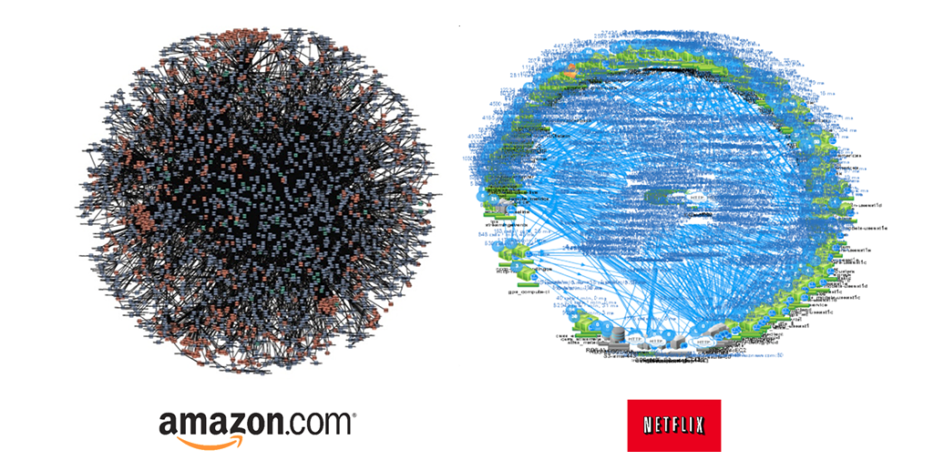
The world is getting more complex!
Notes:
More complex AND faster and at larger scale (IoT, Web Scale, Global, 24/7 operations)

Slide 20
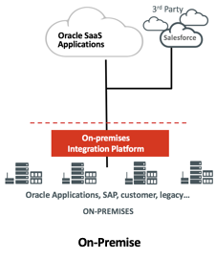
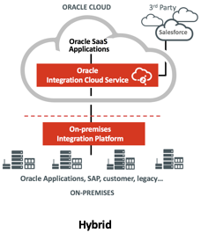
Shift to hybrid integration solutions

Slide 21
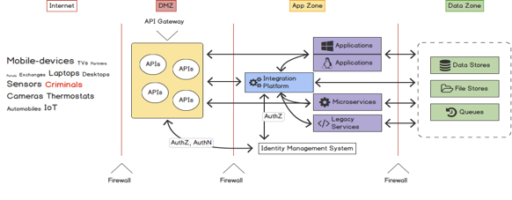
Integration is not just ESB anymore
Modern Integration platforms consists of diverse components
Integration (µ)Services
API Management
Event Hub
https://www.linkedin.com/pulse/when-creating-apis-focus-your-api-gateway-what-does-best-wunderlich

Slide 22









Integration, Big Data and Analytics
Landing Zone
Big Data Platform
Integration
Services
APIs
Data Pipeline / Data Ingestion
Analytics App 1
Analytics App 2
Analytics App 3
Metadata Store
Content Store
Rawdata Store
Analytics App 4
Data Lake

Slide 23
Integration pattern

Slide 24
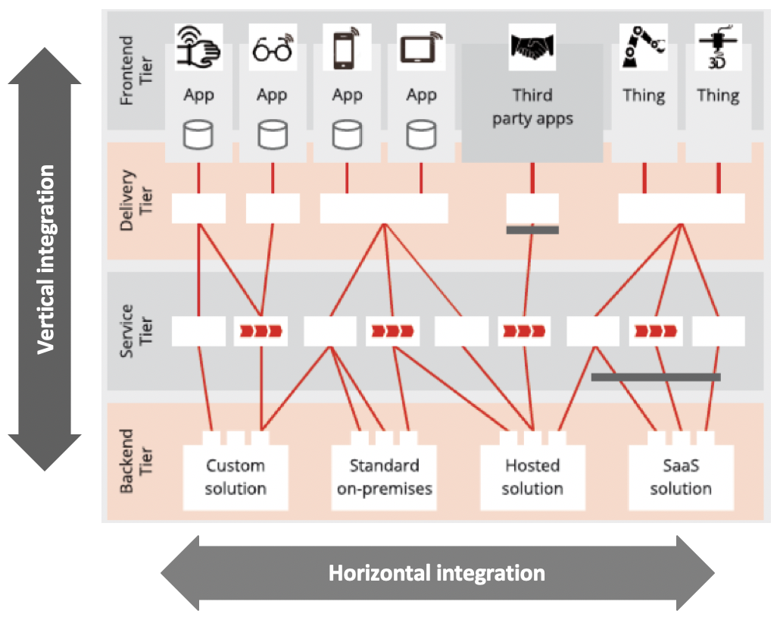
Two dimensions of integration

Slide 25
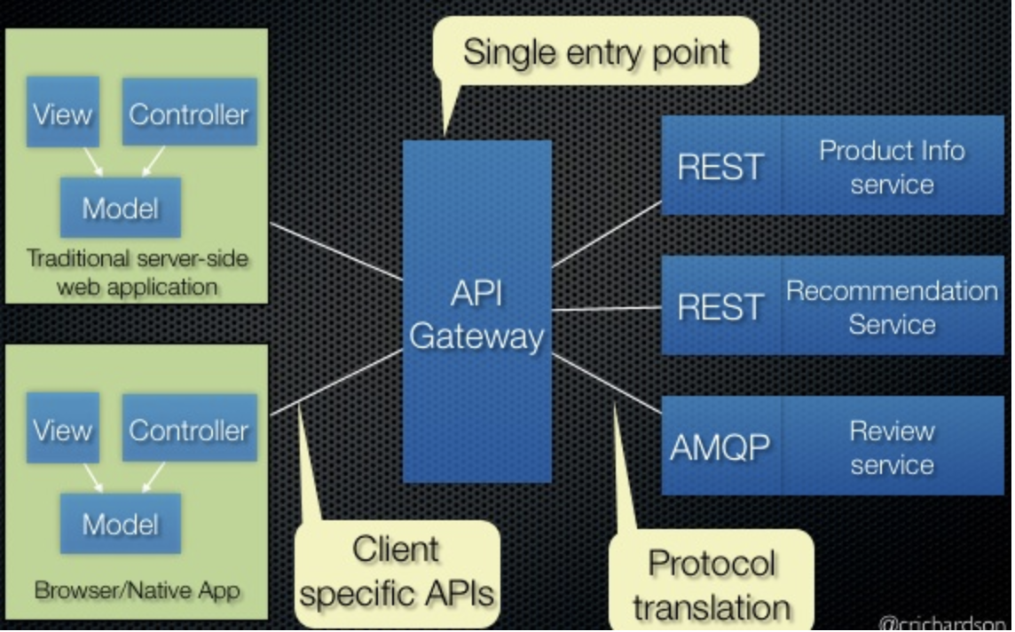
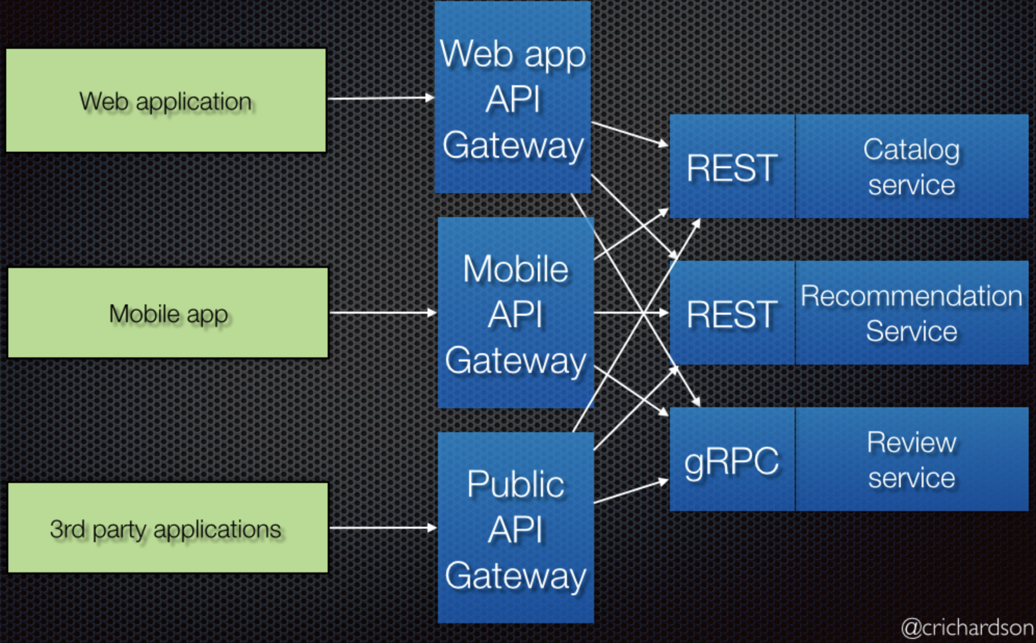
Vertical integration
API Gateway
End User ”integration”
API Gateway as runtime component for
API policy enforcement
Request routing
(Near) Real-time, synchronous interactions
APIs born from business requirements
Who is using the API?
How is the API being used?
Use of lightweight, standard protocols
Backend for Frontend
https://microservices.io/patterns/apigateway.html

Slide 26
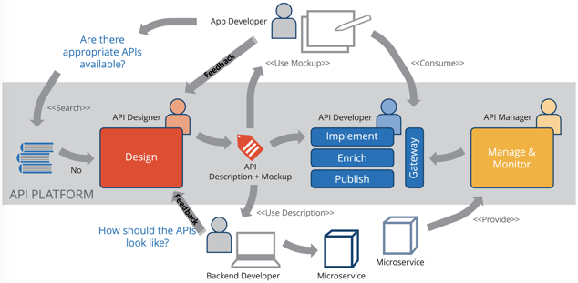
API first design approach

Slide 27
Demo Use Case
Integration of a DB-based CRM system
Client application uses API to
Find/Read Customer data
Create Customer data
Update Customer data
Delete Customer data
API ensures secured access of Customer data
Integration Service takes care of providing the data in the correct format according to the API description
Client Application
Customer API
Vertical Integration
CRM Database

Slide 28
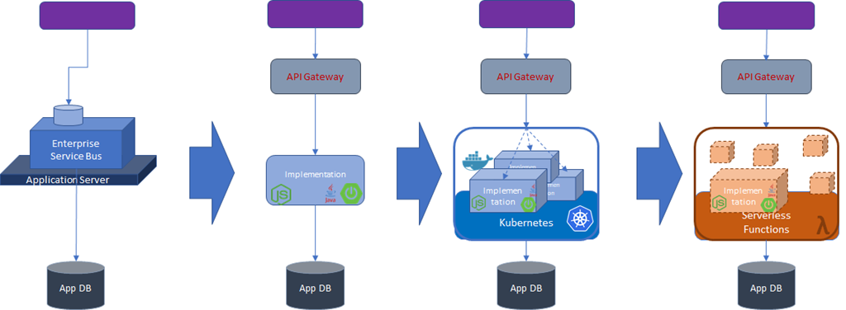
Evolution of ‘vertical integration flow’ implementation
Notes:
Clearly, this evolution leads to increased scalability and reduced overhead in administration of the runtime platform. Compared to the frequently declarative style of development on the ESB platform, there may some initial loss in development productivity. That is easily off set by the much better tool support for automated CI and CD and also compensated by the much wider availability of developers able and willing to with modern, generic technologies compared with vendor specific proprietary platform products.

Slide 29
Horizontal integration
Classic System2System integration
Heavy-weight, proprietary protocols
Technical interfaces
Batch processing
Asynchronous interaction patterns
New insights: relaxed freshness and consistency demands, data replication
New context: cloud, hybrid, “dumb pipes, smart endpoints”, Standard Apps & SaaS evolution
Notes:
Many interactions are not synchronous, do not involve consumers with an urgent request and may be triggered by systems events or simply by time. These interactions typically take place in the background in an asynchronous fashion. These interactions have to be observed as they are executed in the background. Do they get completed successfully? Can they survive the temporary unavailability of the target system? Will processing time stay acceptable when the volume increases?
Critical in the implementation of these interactions is the use of a message queue or an event bus – a decoupling mechanism that provides a bridge across domains, (versions of) systems, locations (cloud & on premises), technologies and time. This event bus also allows load balancing across multiple processors, throttling and circuit breaking in case of limited downstream capacity and is a crucial element in governance.

Slide 30
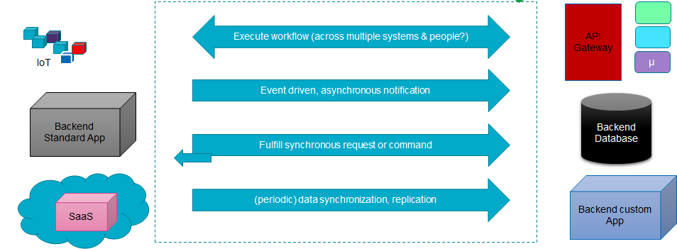
Horizontal integration
Technology & Application Adapters & Connectors, Workflow coordination, Event Bus. Exception Handling, Job Scheduling & Mgt, Transformation, Routing. Monitoring. Streaming Analysis. Authentication.
Notes:
Many interactions are not synchronous, do not involve consumers with an urgent request and may be triggered by systems events or simply by time. These interactions typically take place in the background in an asynchronous fashion. These interactions have to be observed as they are executed in the background. Do they get completed successfully? Can they survive the temporary unavailability of the target system? Will processing time stay acceptable when the volume increases?
Critical in the implementation of these interactions is the use of a message queue or an event bus – a decoupling mechanism that provides a bridge across domains, (versions of) systems, locations (cloud & on premises), technologies and time. This event bus also allows load balancing across multiple processors, throttling and circuit breaking in case of limited downstream capacity and is a crucial element in governance.

Slide 31
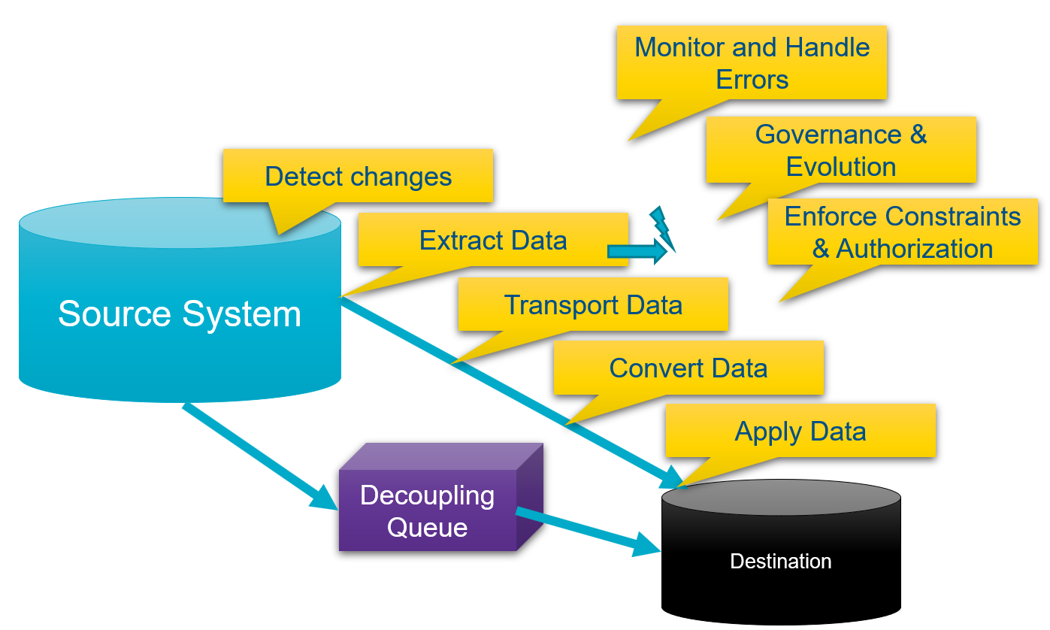
Challenges with Horizontal Integration
Handle requirements for speed, consistency, volume & [global] distribution
Detect Change
Extract Data
Publish Change
Transport
deal with limited connectivity, temporary unavailability
Convert/Transform
Apply
Monitor
Handle exceptions
Enforce constraints & authorization

Slide 32
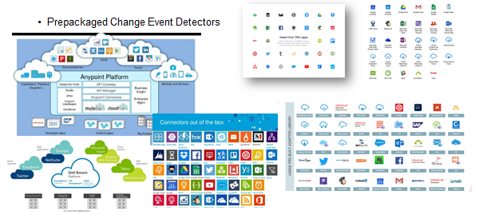
(Cloud) Adapters & iPaaS platforms
Notes:
Challenges (fast enough, consistent enough, volume & global spread):
Detect Change
Extract Data
Publish Change
Transport (deal with limited connectivity, temporary unavailability)
Convert/Transform
Apply
Moniitor
Handle exceptions
Enforce constraints & authorization

Slide 33
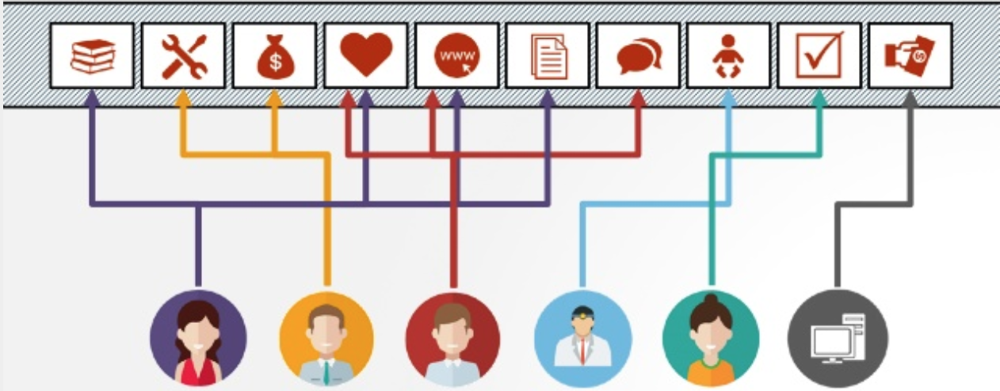
Event-Driven Integration
“Life is a Stream of Events”
https://www.slideshare.net/ConfluentInc/life-is-a-stream-of-events
Notes:
Arturo’s notes:
-The event-first approach is a fundamental paradigm shift of how applications are developed
-Events are facts, things that actually happened; they are therefore immutable and alter the way we perceive system behavior and domain-models, which are key to integration
-Event-driven integration can resemble the “real world” much better than traditional EAI approaches
-Asynchronous communication is the right choice most of the time

Slide 34
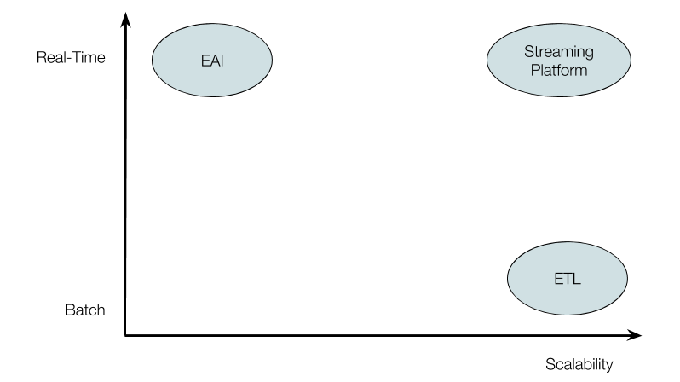
Event-Driven Integration
Systems act and react to internal & external events
Streams of events represent information and behavior
Data should end up in the right places… eventually
Popular design patterns:
Event Sourcing
CQRS
Materialized view
Notes:
Arturo’s notes:
-Event-driven integration leverages technologies such as event logs (Kafka), microservices, CDNs, service-mesh (event-mesh), etc.
-I have some good examples / analogies for Event logs / event sourcing (facebook, whatsapp blue checkmark) and eventual consistency (sharing expenses)

Slide 35
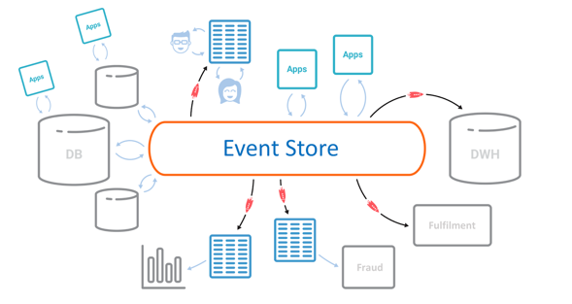
Event-Driven Integration
Notes:
Arturo’s notes:
-This slide I will only show quickly because I really “hate” it, as it’s a really poor way and unimaginative of representing an EDA (basically replacing the ESB by an Event store or event bus)
-Also, one of the main goals of modern architectures / EDAs is to decentralize, decouple, reduce friction & single PoF

Slide 36
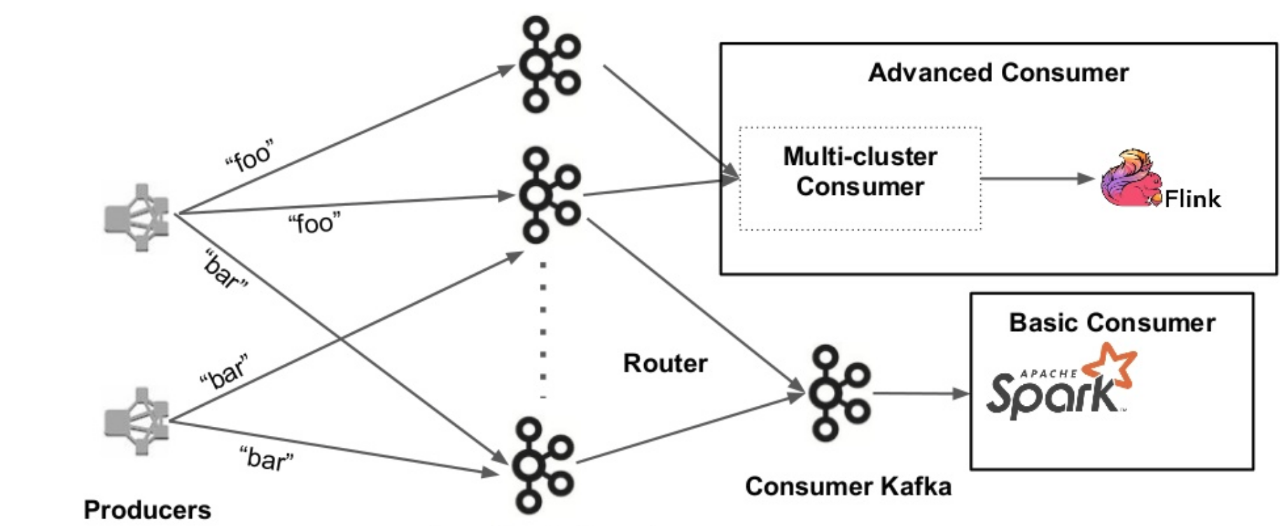
Event-Driven Integration
Notes:
Arturo’s notes:
-What is the proper way of representing an EDA?; that is debatable, but we can definitely say that one of the major advances in integration is that with all the accumulated experience, knowledge, skill, and with the upgraded technologies we are working with, we don’t need to oversimplify or generalize anymore, so that famous slide with the magic box (label it as you will) that integrates everything can be replaced by diagrams representing what’s really going on a bit more closely or accurately.

Slide 37
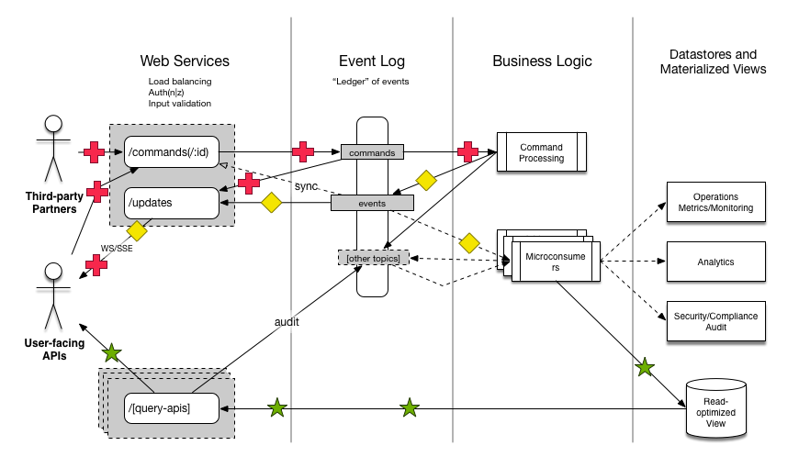
Event-Driven Integration
Notes:
Arturo’s notes:
-What is the proper way of representing an EDA?; that is debatable, but we can definitely say that one of the major advances in integration is that with all the accumulated experience, knowledge, skill, and with the upgraded technologies we are working with, we don’t need to oversimplify or generalize anymore, so that famous slide with the magic box (label it as you will) that integrates everything can be replaced by diagrams representing what’s really going on a bit more closely or accurately.

Slide 38
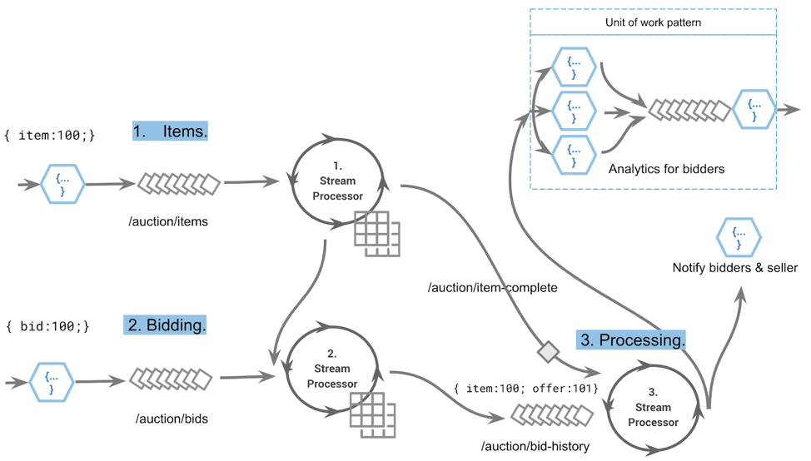
Event-Driven Serverless Architectures
“Serverless functions provide a synergistic relationship with event streaming applications; they behave differently with respect to streaming workloads but are both event driven”
https://confluent.io
Notes:
Arturo’s notes: our title is “From EAI to Serverless”, but in our outline we didn’t mention Serverless explicitly as a topic to cover during the presentation; I added this slide so we can bring serverless into the discussion if we see it fit by tying it up with event-driven integration architecture

Slide 39

Out of the box
Ahead of Time Integration
Collective Data Set
Event Sourcing

Slide 40
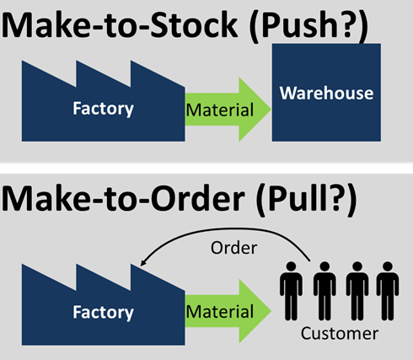
JIT vs AOT

Slide 41
JIT vs AOT Data Integration
JIT
Process [synchronous] request for data ‘just in in time’
Performance overhead suffered at (every) request time
Only data that is requested
Fresh as can be
All authorization rules applied
Single Source of Truth
Transformation & Aggregation at request time
Hard (runtime) dependencies from consumer on producer
AOT
Pre-process / pre-share data ‘ahead of time’
Potentially includes data that will never be requested
Data can be outdated

Slide 42

CQRS => Specialized Query Stores
Cater for different (read) Data Usage Scenarios
Different in:
Why
What – grain, aggregation, breadth, type of and variation in queries
How – format, language, accuracy and freshness, consistency
When – frequency, time of day | week | month, 24/7
Where – latency, band width, off line
Who – scale, different roles & user groups

Slide 43

CQRS => Optimized Data Set for Special Use Case
Shape & Format
Right Grained (aggregation, consolidation)
Filtered
Enriched (from multiple sources)
Location
Time (refreshed at the right time)
Search Options
BASE (eventually – when? – consistent)
Authorization
GDPR
Frontend
BFF API
C
Q

Slide 44
Collective Data Set

Slide 45
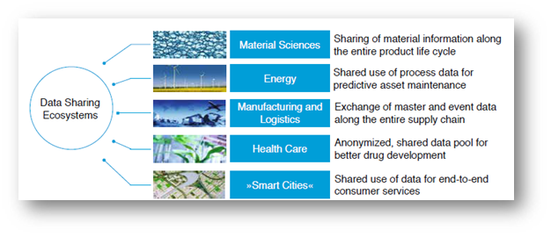
Data Sharing Ecosystems
Multiple independent organizations
Mutually benefit from having access to the same Data at the same time
Share data & Have access to data with minimum of overhead and with equality among the ecosystem partners
Partners are on different network domains, physical locations, technology stacks, …
New Partners can join
Partners can leave
Consensus on what constitutes correct data

Slide 46
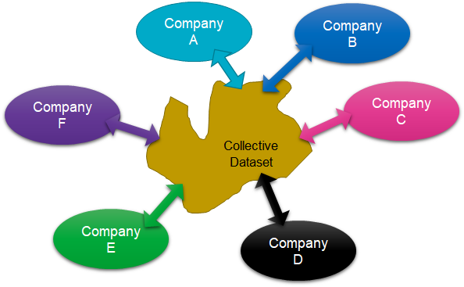
Collective Data Set

Slide 47
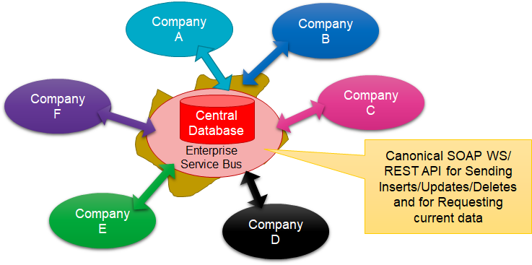
Collective Data Set

Slide 48
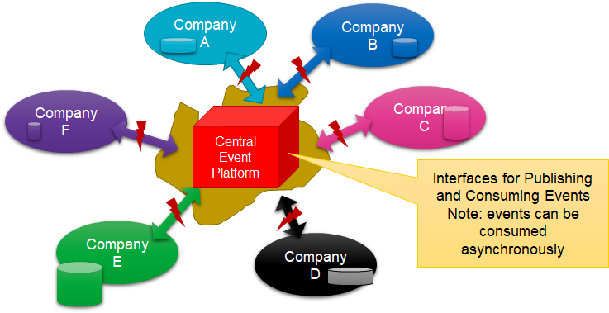
Collective Data Set == Collective Data Change Events

Slide 49
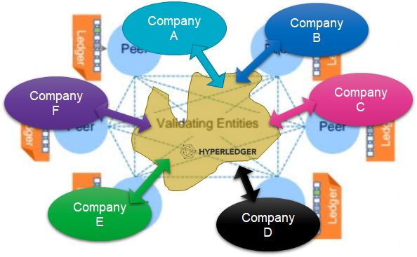
Collective Data Set => Chained Distributed Data Store

Slide 50
Conclusion
Notes:
It is important to recognize that on the one hand there are many data flows in our enterprise IT landscapes that are really very similar – in essence bringing data from A to B. A lot can be gained by approaching all these flows as part of the same spectrum. On the other hand, the various shades of data flow on the integration spectrum require different approaches as well. Common data models, domain driven design and a desire for decoupling, statelessness and dynamic scalability are similar but the implementation technologies will be different. No longer should we use the ESB platform the hammer that can take on any data integration challenge as a nail. As a first step, let’s liberate synchronous interactions supporting on line clients such as Web Portals and Mobile Apps from the ESB. Let’s embrace the API Gateway plus scalable API implementation – perhaps first through containers and eventually using a serverless implementation. And let’s adopt a message queue or event bus that is scalable, accessible cross technologies and distributed – reliable and spanning across clouds and on premises.

Slide 51
Key Takeaways
Integration is more relevant than ever
Integration scenarios are increasingly complex because of:
Data volumes
Hybrid ecosystems
Platform criticality
Enables modern business models
Leverages technology and architecture
3 main integration styles (Vertical, Horizontal, Event-Driven)
Technology and concepts are evolving but integration patterns stay the same
Asynchronous should be the preferred communication style

Slide 52
Questions & Answers
Thanks for your attention!

